Slide 1

Introduction to the Research Computing Center (RCC)
KICP/AA Workshop
H. Birali Runesha, Jonathan Skone, Raj Shukla
January 30, 2020
rcc.uchicago.edu

Slide 2
KICP/AA Workshop
Session 1: Introduction to computing at RCC
9:00 AM -10:00 AM, ERC 576
January 30, 2020
rcc.uchicago.edu

Slide 3
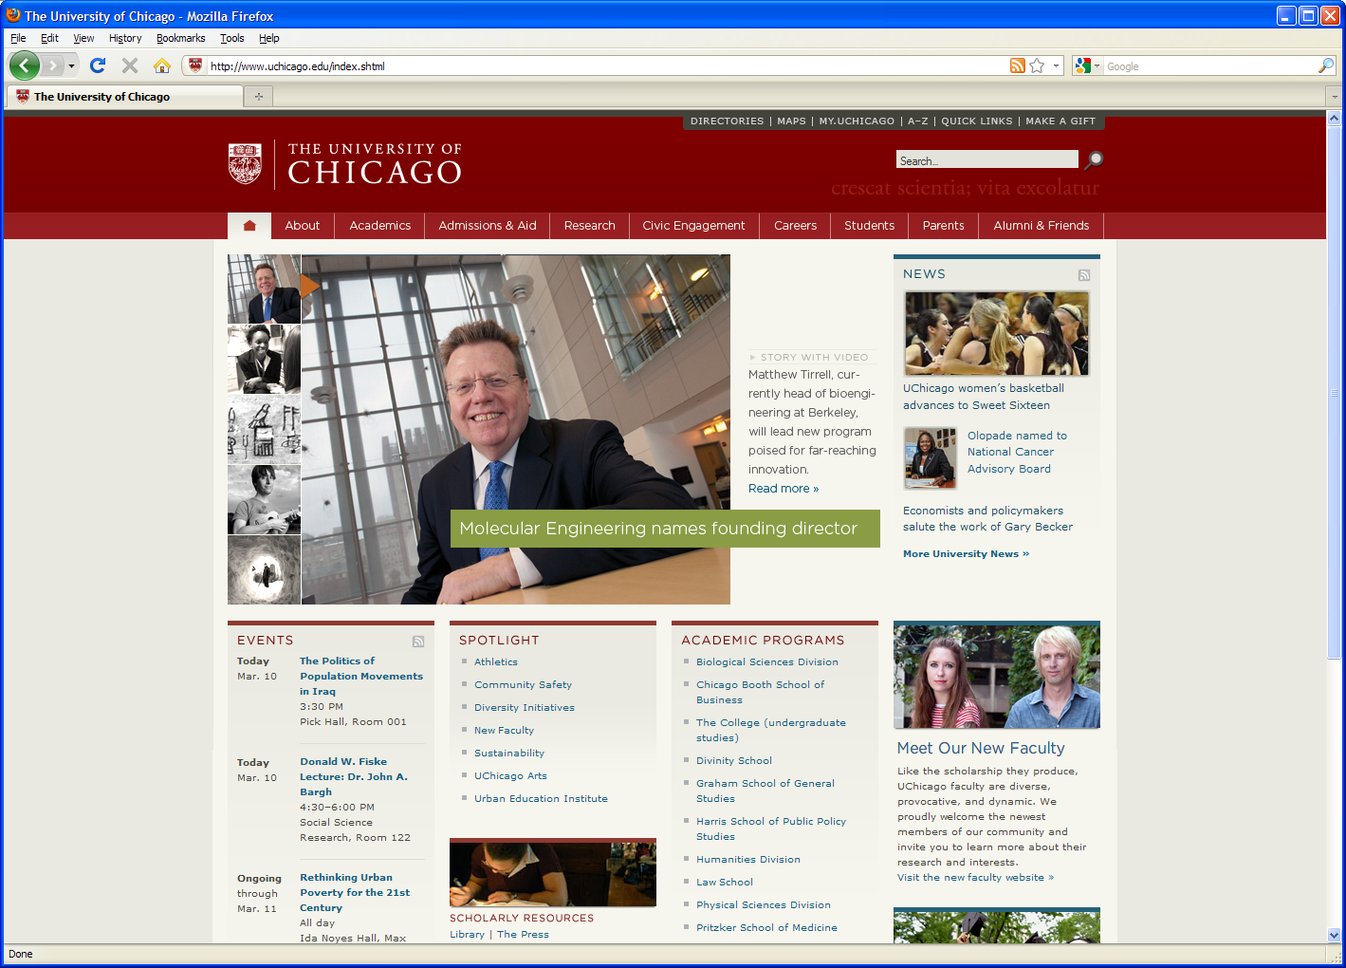
Overview
RCC mission
RCC Programs and Services
RCC Core resources: The Midway ecosytem
Getting an account at RCC – Allocation process
Login procedures

Slide 4
RCC Mission
The RCC mission is to advance research and scholarship by providing access to centrally managed high-end computing, storage and visualization resources. These resources include not just hardware and software, but also expert technical user support, education and training.

Slide 5

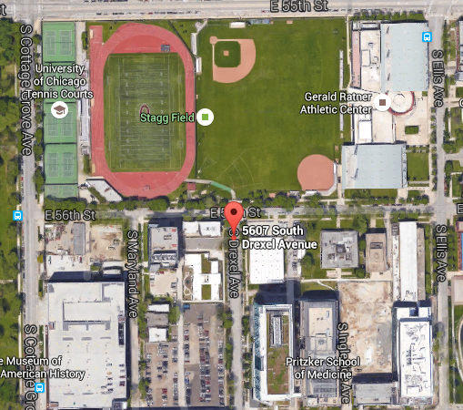
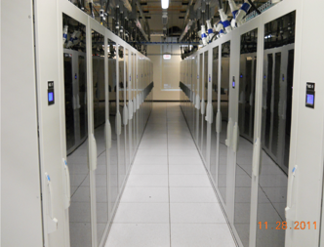
Who and Where we are
Who
The RCC is a unit in the Office of Research
and National Laboratories
Where are we located?
Regenstein room 216: A Go-To Place
Central office: Located at 5607 S. Drexel Ave
Zar Room: Data Visualization Lab
Data center: 6045 S. Kenwood Ave
Website: https://rcc.uchicago.edu
Help line: help@rcc.uchicago.edu
TACC

Slide 6
RCC Core Services
A unit in the Office of Research and National Laboratories
“Provide access to hardware (computing, storage, and visualization resources), software and advanced technical support”
Hardware
Software
Technical Support
High End Computing
Tightly and Loosely coupled nodes
Commercial software
Licensing
Consulting
Data Visualization
Research Storage
Data Management and Backup
Public/Community
codes
Education and Training
Grants
Special Hardware GPU, Shared memory, NVme
Homegrown
codes
Application Software Development

Slide 7
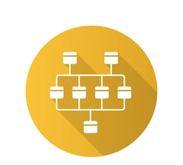





RCC Programs and Services
Cluster Partnership Programs
GM4
Consultant Partnership Program
Hardware
Software
Consultants
Outreach Workshops
Tutorials & Course support
Affiliate
(Argonne, FermiLab, MBL)
Secure Data Enclave: MidwarR
Cloud - Skyway
Data Management
Reproducibility
DaLI
Notes:
Since its 2012 launch, the RCC has grown and continues to establish itself as a premiere centralized research and consulting center

Slide 8
Cluster Partnership Program (CPP)
Researchers can purchase compute node and storage
Tightly coupled nodes
Loosely coupled nodes
GPU nodes
Large shared memory nodes
High Performance storage
Capacity storage
Tape backup
PARTNER hardware is similar to Midway hardware
For special requests, contact help@rcc.uchicago.edu
CPP
Heavy discounts- Bulk purchase
Access to RCC tech support
Professional System administration
Access to emerging technologies
Hosting of faculty hardware
Access to RCC software
Backup - Tape library
Leverage RCC Outreach
Compliance with Data Management requirements
Notes:
Here are some of the thing sthat help us reduce setup time from months to day:
Identify advanced technology
Negotiate competitive prices
Provide hardware next day whenever possible
Secure appropriate data center space
Receive and rack equipment
Install professionally developed OS image
Manage burn-in, performance testing
Manage queue policy considerations
Manage account creation and authentication
Provide centrally managed software repository
Provide data backups
Provide assistance to new users
Provide basic user support
Offer hands on training, consulting
Quietly deal with hardware issues

Slide 9
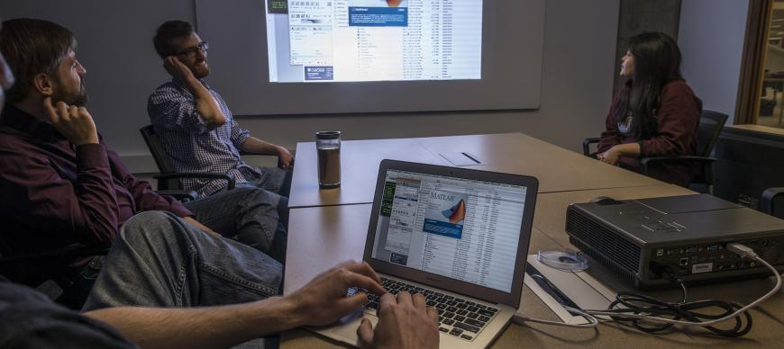
RCC Computational Scientist Partnership Program
Allows faculty to contribute funds in exchange for dedicated support
Researchers supporting the program will have access to not one, but a pool of computational scientists
General user support is provided to all RCC users at no additional costs.

Slide 10
What is High Performance Computing?
High Performance Computing (HPC) is the “practice of aggregating computing power in a way that delivers much higher performance than one could get out of a typical desktop/laptop computer”
High-End Computing?
High-End Computing (HEC) refers to computing systems that employ hundreds or even thousands of times more computational power than an average computer system.

Slide 11
Why HPC, HEC?
To tackle big problems, we need big computers
Types of big problems
Compute Intensive
A single problem requiring a large amount of computation
Memory Intensive
A single problem requiring a large amount of memory
Data Intensive
A single problem operating on a large amount of data
High Throughput
Many unrelated problems to be executed in bulk

Slide 12
Some definitions
A processor is the logic circuitry that responds to and processes the basic instructions that drive a computer. The term processor is used interchangeably with the term central processing unit (CPU), although strictly speaking, the CPU is not the only processor in a computer.
Core: The smallest compute unit that can run a program
Socket: A compute unit, packaged as one and usually made of a single chip often called processor. Modern sockets carry many cores (10, 14, or 20, 24, 28, etc. on most servers)
Node: A stand-alone computer system that contains one or more sockets, memory, storage, etc. connected to other nodes via a fast network interconnect.
Notes:
A processor, or "microprocessor," is a small chip that resides in computers and other electronic devices. Its basic job is to receive input and provide the appropriate output. ... The central processor of a computer is also known as the CPU, or "central processing unit.” The central processor of a computer is also known as the CPU, or "central processing unit." This processor handles all the basic system instructions

Slide 13
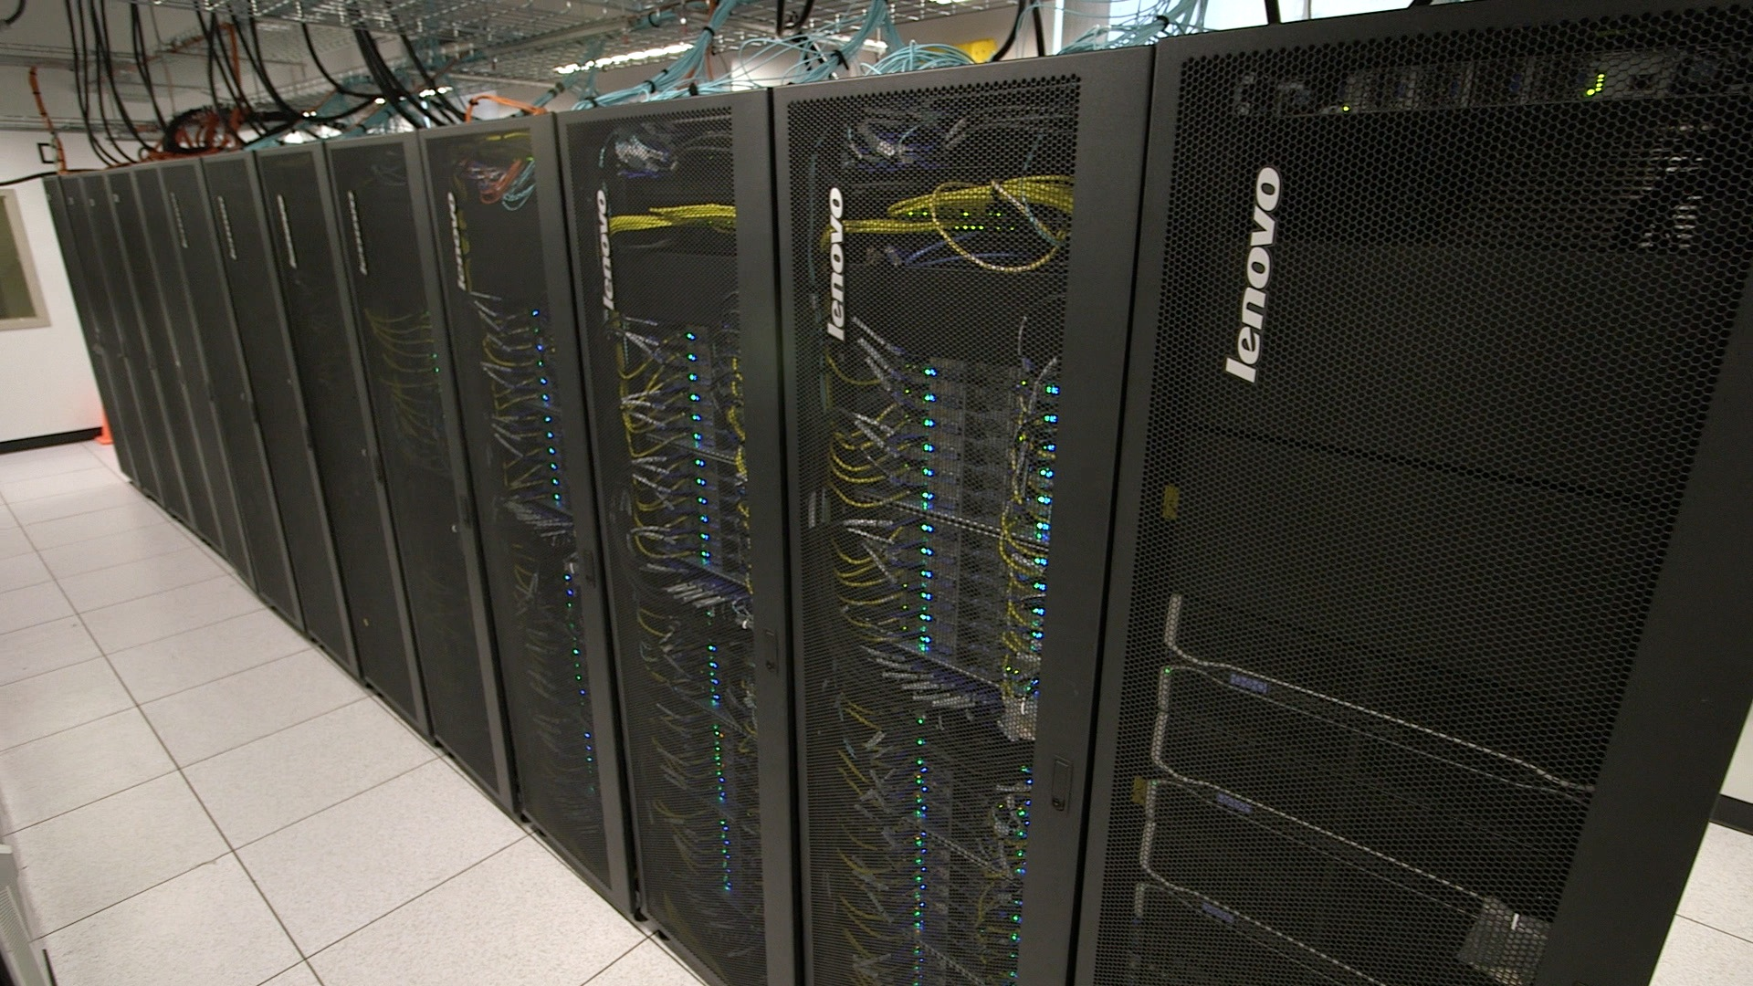
From a CPU to a Cluster
CPU
Motherboard
Socket
Cabinet
Compute Node
Cluster
Rack

Slide 14
Distributed vs Shared Memory Systems
P1
P2
P1
Mem 2
P2
P
P
P
Mem 2
P
Shared Memory
Mem 1
Node1
Network
Node2
P
Mem 3
P
P
Mem 4
P
Node3
Node4
Distributed Shared Memory
Supercomputing Institute
for Advanced Computational Research

Slide 15
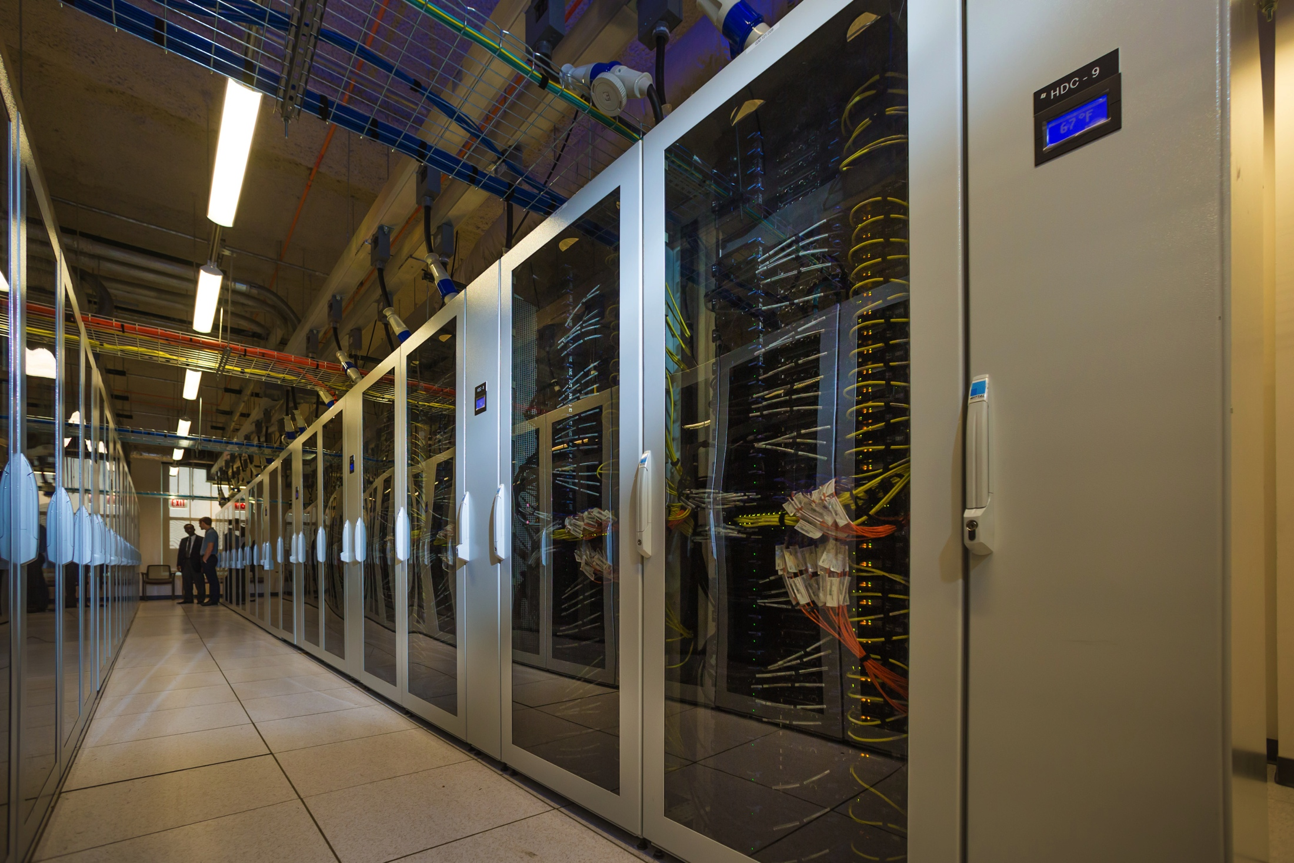
Understanding the RCC Compute Ecosystem:
MIDWAY

Slide 16
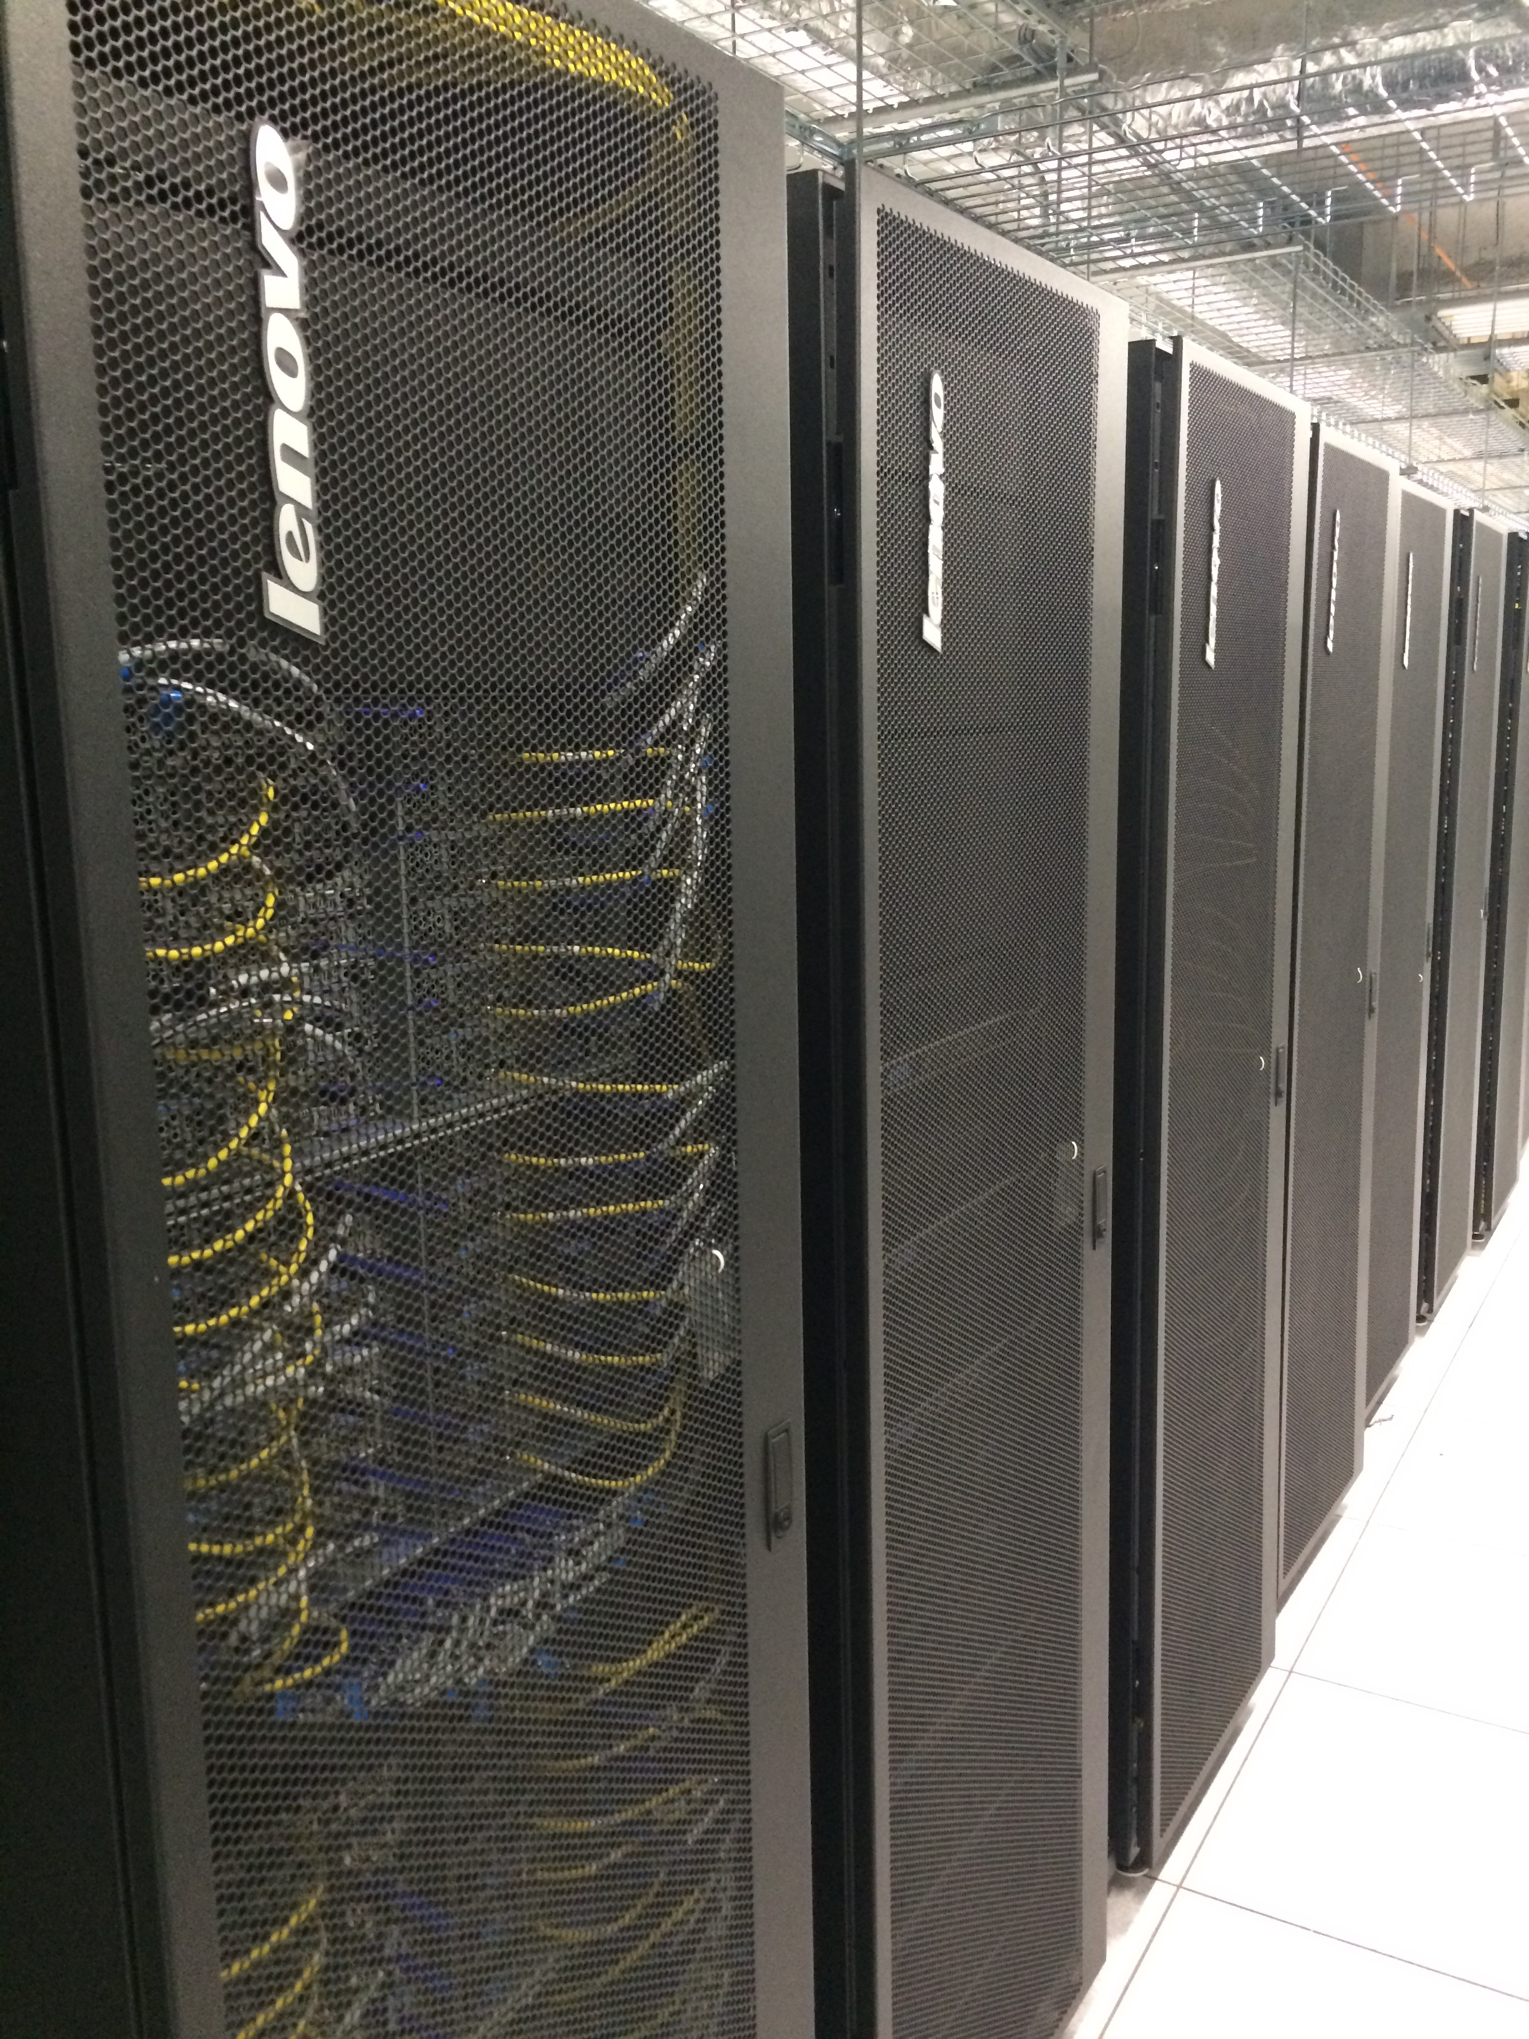
The RCC compute cluster
Computing hardware
367 nodes total
342 tightly coupled Broadwell nodes ( 10,360 cores)
Two intel E5-2680v4 processors per node (14 core/proc)
155 nodes have EDR network card
187 nodes have FDR network card
6 NVidia Tesla K80 GPU nodes (4 GPU cards/node)
5 large shared memory nodes (512GB each)
14 dual socket loosely-coupled Broadwell nodes
Cluster Partnership Program: 1000+ nodes
900+ tightly coupled infiniband nodes
20+ Big memory nodes
100+ Nvidia GPU nodes
RCC Manages 1515 nodes
(35,904 cores) on Midway2

Slide 17
RCC Hardware: Midway2 (Shared)
Cores(Nodes) | CPU | Memory | Network
5236 (187) | 2.4GHz Intel Broadwell | 64GB | EDR 100Gbit/s InfiniBand
4,340 (155) | 2.4GHz Intel Broadwell | 64GB | FDR14 56Gbit/s InfiniBand
140 (5) | 2.4GHz Intel Broadwell | 512GB | FDR14 56Gbit/s InfiniBand
504 (14) | 2.4GHz Intel Broadwell | 64GB | 1 GigE
Cores (Nodes) | CPU Accelerator | Memory | Network
168 (6) | 2.4GHz Intel Broadwell NVIDIA Tesla K80 | 128GB | FDR14 56bit/s InfiniBand
Notes:
FDR 4x 40 Gbit/s
Sandyb: Intel Xeon CPU E5-2670 @ 2.60GHz – cores: 8 – HT disabled - cache: 20MB– socket: LGA2011
Westmere: Intel Xeon CPU X5675 @ 3.07GHz – cores: 6 – HT disabled – cache: 12MB – socket: ZIF Socket
AMD: Abu Dhabi AMD Opteron(tm) Processor 6386 SE
Sandybridge: IBM System X iDataPlex dx360 M4 Server
Westmere: IBM System X iDataPlex dx360 M3 Server
Bigmem: IBM System x3650 M4
AMD: Dell PowerEdge R815
448TC
96LC
----- Meeting Notes (9/13/13 15:38) -----
fix 32gb memory
sandyb in phi nodes
fix keplar spelling
bigmem03
bigmem has 48 cores?
partition flag

Slide 18
RCC Hardware: Midway2 (Shared)
Cores(Nodes) | CPU | Memory | Queue
5180 (185) | 2.4GHz Intel Broadwell | 64GB | broadwl
5180 (185) | 2.4GHz Intel Broadwell | 64GB | broadwl
168 (6) | 2.4GHz Intel Broadwell | 512GB | bigmem2
504 (18) | 2.4GHz Intel Broadwell | 64GB | broadwl-lc
Cores (Nodes) | CPU Accelerator | Memory | Queue
168 (6) | 2.4GHz Intel Broadwell NVIDIA Tesla K80 | 128GB | gpu2
Notes:
FDR 4x 40 Gbit/s
Sandyb: Intel Xeon CPU E5-2670 @ 2.60GHz – cores: 8 – HT disabled - cache: 20MB– socket: LGA2011
Westmere: Intel Xeon CPU X5675 @ 3.07GHz – cores: 6 – HT disabled – cache: 12MB – socket: ZIF Socket
AMD: Abu Dhabi AMD Opteron(tm) Processor 6386 SE
Sandybridge: IBM System X iDataPlex dx360 M4 Server
Westmere: IBM System X iDataPlex dx360 M3 Server
Bigmem: IBM System x3650 M4
AMD: Dell PowerEdge R815
448TC
96LC
----- Meeting Notes (9/13/13 15:38) -----
fix 32gb memory
sandyb in phi nodes
fix keplar spelling
bigmem03
bigmem has 48 cores?
partition flag

Slide 19
Schematic of the Midway Cluster

Slide 20
KICP/AA Dedicated hardware
Cores(Nodes) | CPU | Memory | Network
240 (6) | 2.3GHz Intel Cascade | 192GB | EDR 100Gbit/s InfiniBand
32 (1) | 2.3GHz Intel Cascade 2 GPUs NVIDIA V100 | 192GB | EDR 100Gbit/s InfiniBand
Nodes will be upgraded with the new Midway3
Current hardware specification
6 Compute nodes: 2.4 GHz Intel Broadwell, 64GB and 28 cores per node
1 GPU node with 2 Nvidia V100 cards per node and 2.4 GHz Skylake, 96 GB and 40 cores per node
Partitions: kicpaa and kicpaa-gpu

Slide 21
KICP/AA Dedicated hardware
Cores(Nodes) | CPU | Memory | Queue
240 (6) | 2.3GHz Intel Cascade | 192GB | kicpaa
32 (1) | 2.3GHz Intel Cascade 2 GPUs NVIDIA V100 | 192GB | kicpaa-gpu
Nodes will be upgraded with the new Midway3
Current hardware specification
6 Compute nodes: 2.4 GHz Intel Broadwell, 64GB and 28 cores per node
1 GPU node with 2 Nvidia V100 cards per node and 2.4 GHz Skylake, 96 GB and 40 cores per node
Partitions: kicpaa and kicpaa-gpu

Slide 22
Midway2 Storage
High Capacity storage: /project2
3.8 PB of storage
Backed up to tape system
7 daily and 4 weekly snapshots located at /snapshots/project2
7 day grace period on over quota
High Performance storage: /scratch/midway2
190 TB usable
Not backed up
100 GB user soft quota
30 day grace period on over quota
Home directory space: /home
61 TB of capacity
Each user has 30 GB quota
7 day grace period on over quota
7 daily and 2 weekly snapshots located at /snapshots/home
22

Slide 23
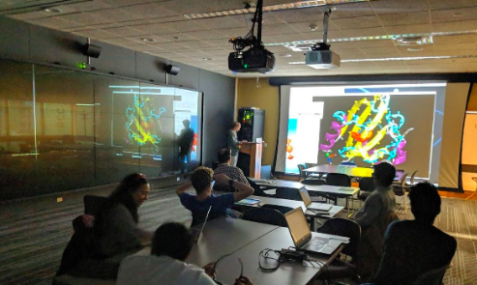
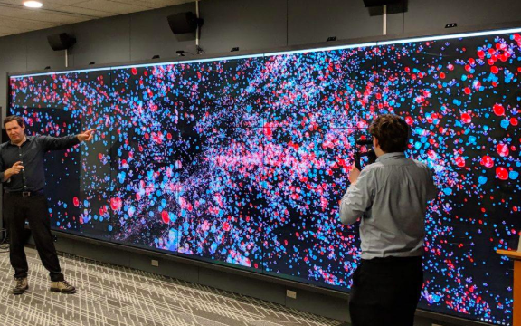
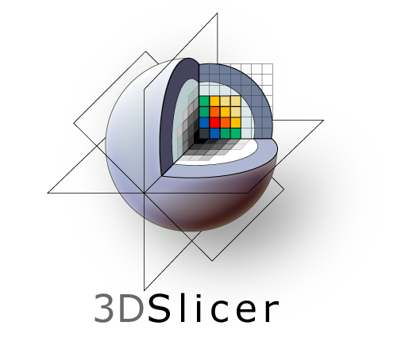

Data Visualization Laboratory
3D MRI-CT Reconstruction
High-resolution data visualization wall
3D Stereo projector
General scientific visualization
HTC Vive Virtual Reality System
Remote visualization and sharing SAGE2
Visualization tools…Paraview, Amira, etc.
Notes:
Add Amira software
The data visualization lab also has a 3D stereo projector and HTC vive

Slide 24
Getting an Account
at RCC

Slide 25
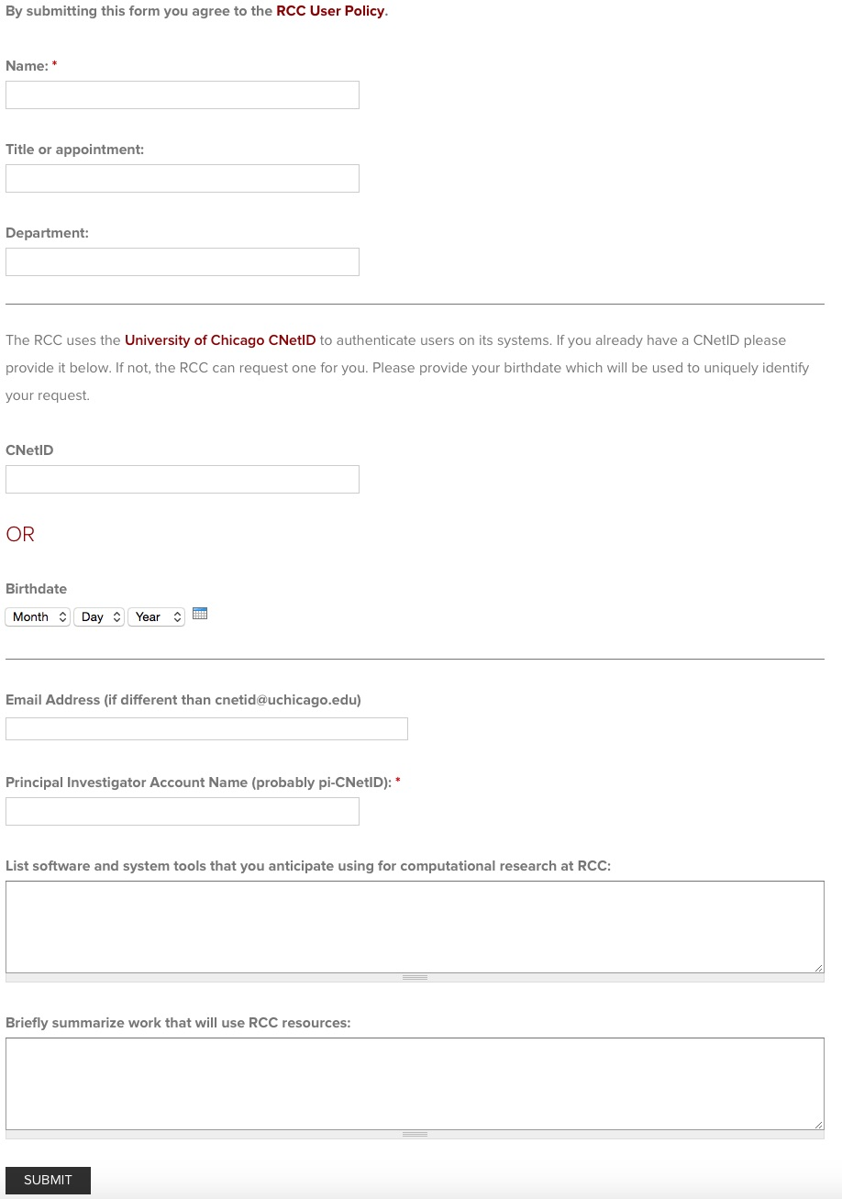
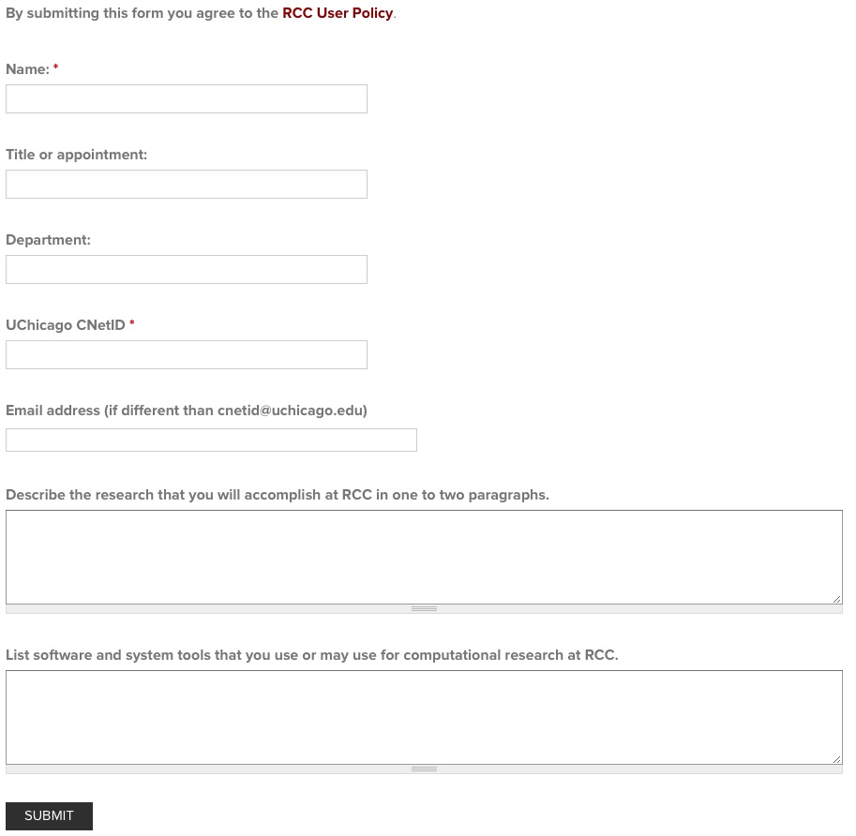
How to get an account at RCC
PI Account Request
General User Account Request
To be able to use the Midway ecosystem, you need an RCC account: https://rcc.uchicago.edu/accounts-allocations/request-account

Slide 26
RCC Account types
Startup: small allocations given to all PIs.
Research:
Type I: Allocation for small research projects. Reviewed by RCC and provided upon request.
Type II: Larger research projects with significant resource requirements. Reviewed bi-annually by allocation committee.
Education: allocation to support courses or workshops for a number of users over a limited period.
Special: Timely or “heroic” research programs that cannot be satisfied by the standard research allocation.

Slide 27
Allocation Policy
Allocations of projects accounts provided throughout the year.
All Principal Investigators (PIs) Automatically receive a startup account.
Larger allocations (Research and Special) to be reviewed.
Allocation period starts October 1st
Allocation to expire on September 30th of each year.
To check account balance:
Accounts balance: accounts balance
Accounts usage: accounts usage
Notes:
Please explain the SU calculation. This is the calculator, https://rcc.uchicago.edu/others/su.php

Slide 28
What is a Service Unit?
Service Units (SUs) are a measure of the amount of computing resources consumed on a compute cluster
SUs are virtual money to do computation on a cluster
In standard settings, 1 SU equals to the usage of 1 processing unit (e.g., core) for 1 hour
SUs are allocated through different allocation mechanisms

Slide 29
How to Login RCC computers and Transfer files

Slide 30
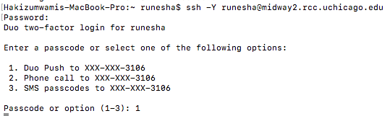
Login procedure
Since November 2018, RCC users are required to use the two-factor authentication to be able to use RCC resources
Please see https://2fa.rcc.uchicago.edu to enroll
Once you have a Midway account, you need your CNet_ID and password and an SSH client to connect to Midway
On a Mac or Linux computer open a terminal and run the following command:
ssh –Y CNet_ID@midway2.rcc.uchicago.edu
example: ssh –Y runesha@midway2.rcc.uchicago.edu
Notes:
Increase resolution of images

Slide 31
Login procedure (Cont’d)
On a Mac or Linux computer
Mac users will not have XQuartz X server installed by default. You will need to download and install it from the XQuartz project page.
NOTE: Users are encouraged to install the older 2.7.8 version of Xquartz if they intend to run OpenGL applications (e.g. VMD, gaussview, etc).
On a Windows computer install an SSH client such as Putty or MobaXterm and set it up as:
Hostname: midway2.rcc.uchicago.edu
Port: 22
Username: CNet_ID
Password: CNet password
MobaXterm comes with a built-in X server
Windows 10 (still in Beta) supports SSH
Go to “Manage optional features” in your Start Menu, and then click on on “Add a feature”

Slide 32
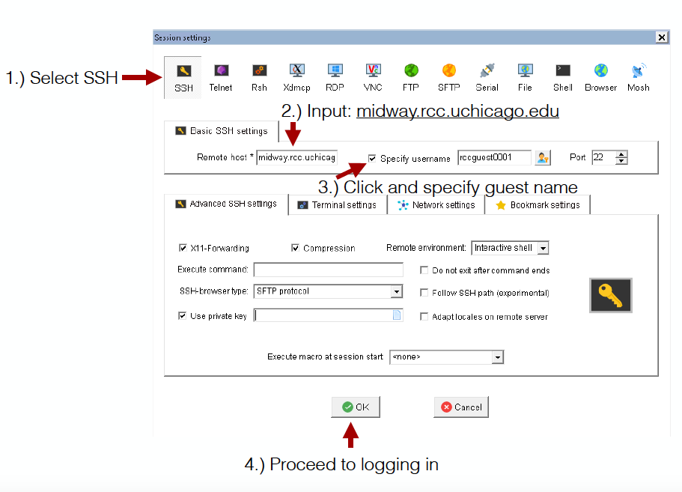

Software 18 Commercial and 186 Publicly available software are installed and maintained at RCC (341 different modules)
Windows Users: MobaXterm client

Slide 33
Using guest/temporary accounts
Note the 4 digits on the back of
the key. Your guest username will be
rccguestXXXX (e.g. rccguest8453)
Connect your Yubi key and press and hold the
button to enter your password
Use your favorite ssh client to log into midway2.rcc.uchicago.edu
Connect your Yubi key and press and hold the
button to enter your password

Slide 34

Login procedure (Cont’d)
Using ThinLinc via browser
Open a browser and connect to https://midway2.rcc.uchicago.edu
You may receive a warning about the certificate and you need to ignore or add an exception
Login using your CNetID and password
Does not work with the temporary guest accounts
You will be required to use 2FA
Open a terminal when you are logged in
Alternatively, you could download the ThinLinc client and connect to Midway2

Slide 35
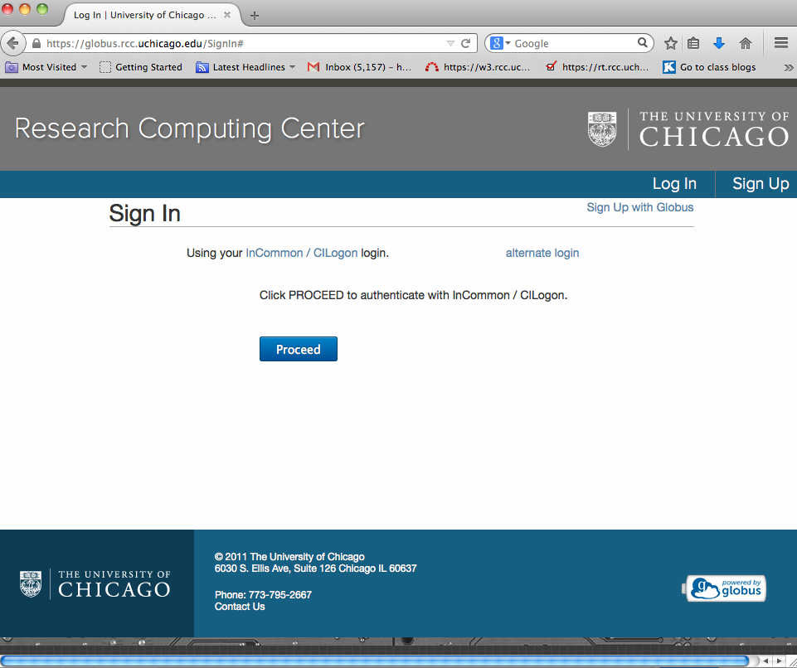
Transferring Files
Secure copy protocol: scp or rsync on Linux and Mac computers
scp local_file CNet_ID@midway2.rcc.uchicago:
scp -r –avzP local_folder CNet_ID@midway2.rcc.uchicago:
rsync –avzP local_file CNet_ID@midway2.rcc.uchicago:
rsync –avzP local_folder CNet_ID@midway2.rcc.uchicago:
Using a GUI-based tool (FileZilla for example) on Windows, Linux, or Mac set up as per FileZilla tab on https://2fa.rcc.uchicago.edu/getstarted.html
Globus Online
use endpoint: ucrcc#midway
https://globus.rcc.uchicago.edu
Notes:
increased resolution of text image.
SAMBA is available on Windows, Mac and Linux
Removed HTTP protocol for file transfer

Slide 36
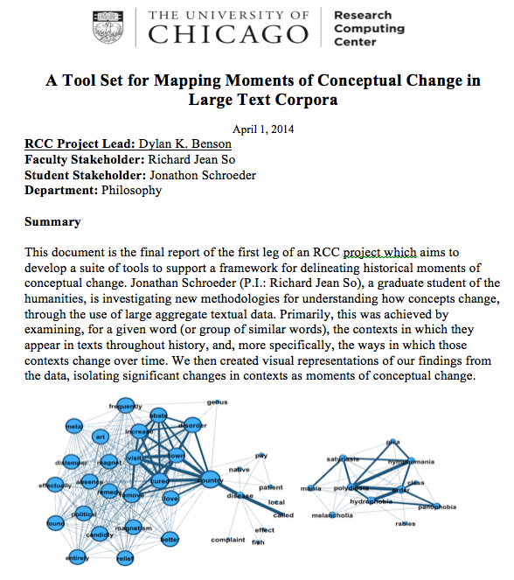
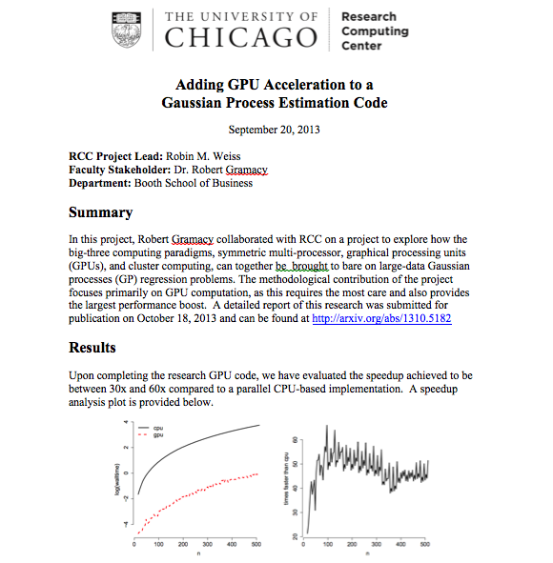
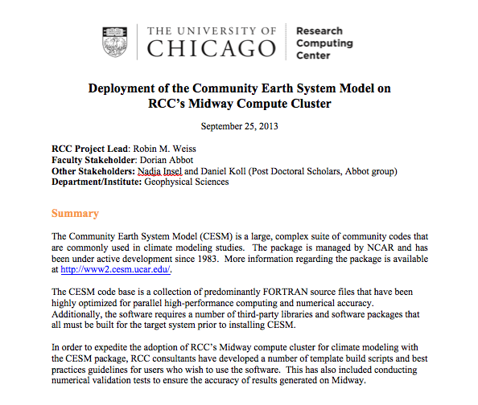
RCC Advanced Technical Support
Parallelization of serial codes
AI – Machine and Deep Learning
Code development and optimization
E.g.: RCC consultants achieved up to 1300 times speed up
Software development
Application software development
Grant support
RCC defines Computational Scientists as RCC staff experienced in both primary research as well as computing and visualization techniques relevant to their field of expertise.

Slide 37
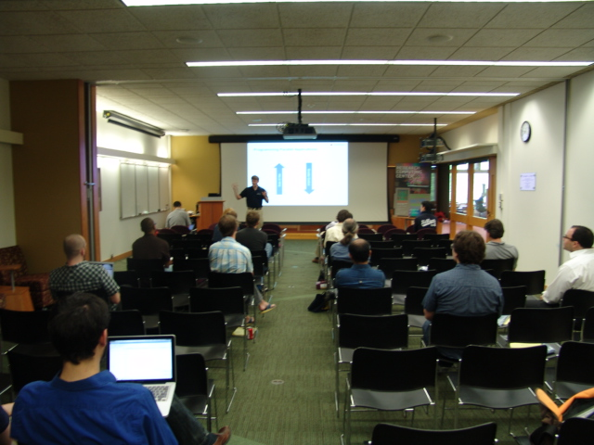
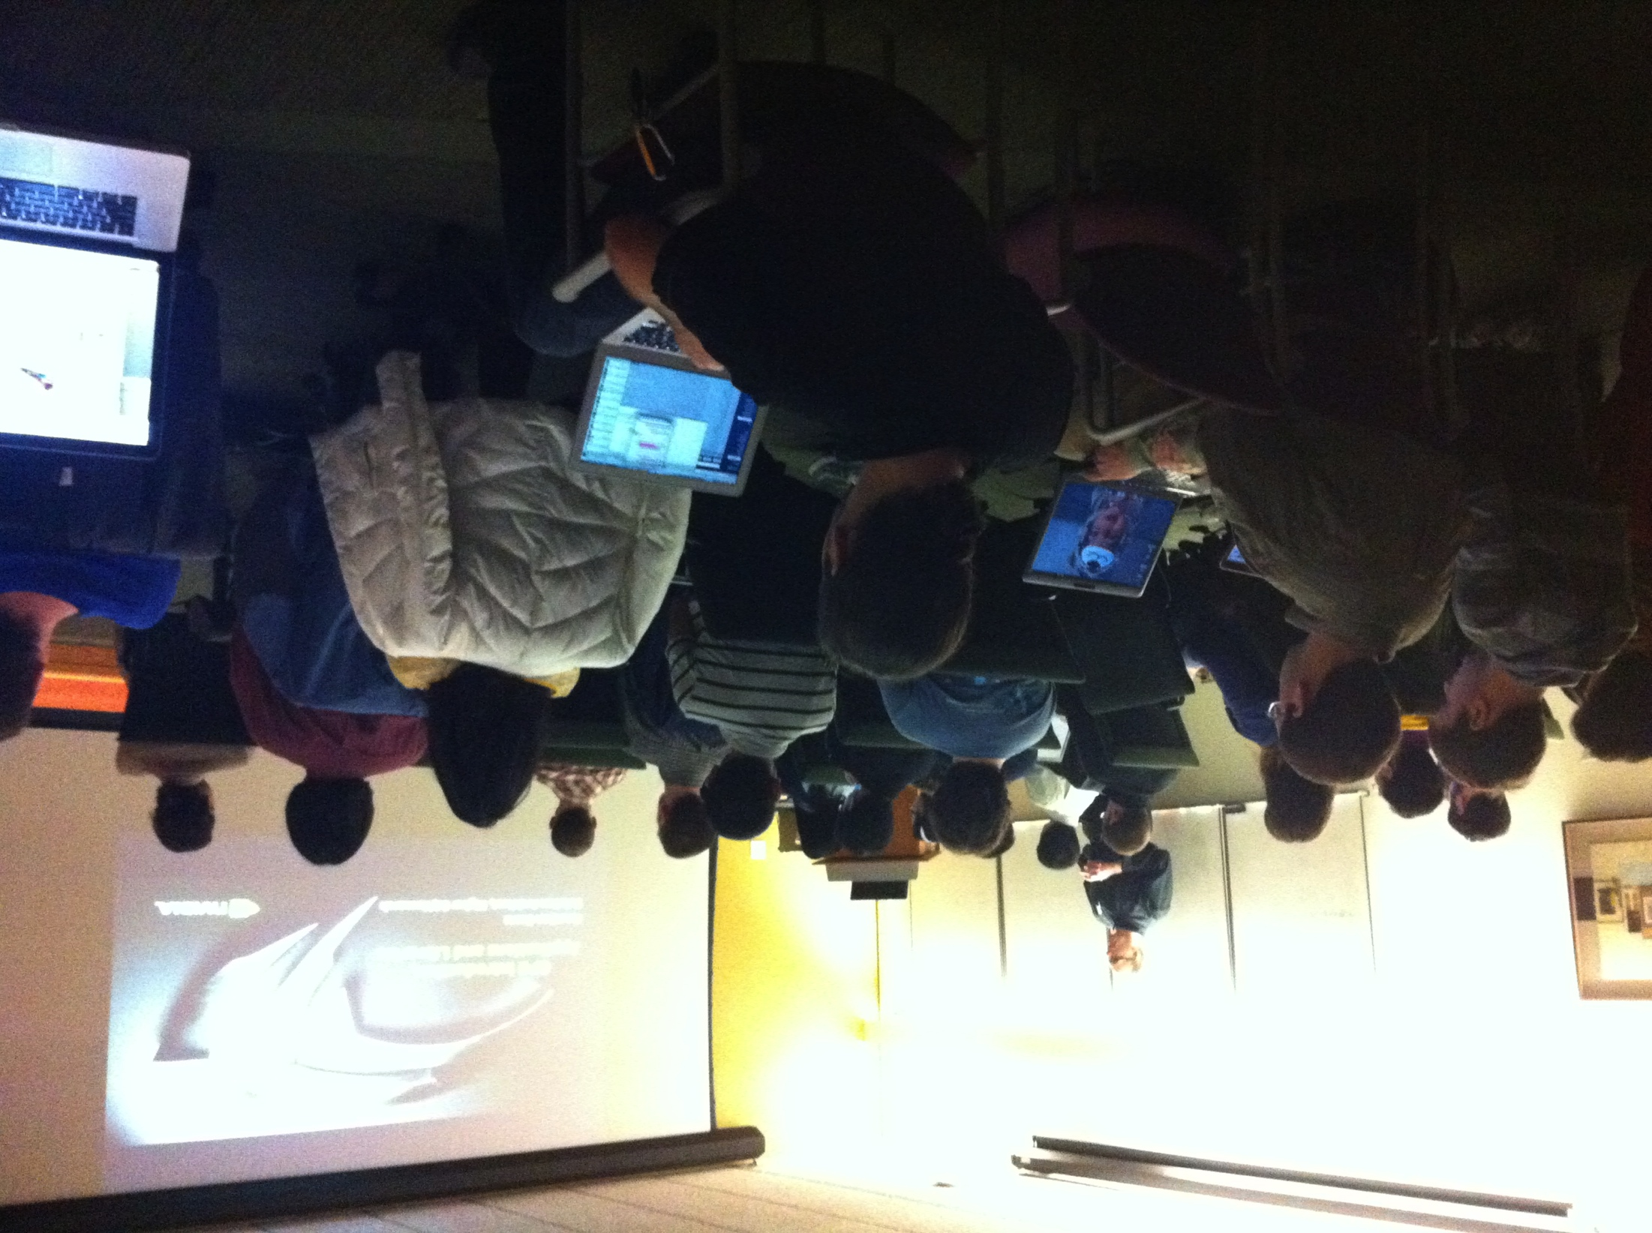
Workshops, Tutorials and Advanced Training
Scheduled throughout the year
Invite software vendors
One on one
Hackathons
Boot camps

Slide 38
Workshops/Tutorials/Seminars
https://rcc.uchicago.edu/support-and-services/workshops-and-training
Spring 2020 Workshops
1/21/20: Introduction to the RCC
1/28/20: Analysis of Genetic Data 1: inferring population structure
2/4/20: Introduction to ArcGIS
2/11/20: Intermediate ArcGIS
02/20/20: Introduction to Computer Vision in Python
02/25/20: Neural Networks for Word Vectors and Word Embeddings in Python
03/10/20: Performance Guidelines of Neural Network Models
03/17/20: Web Scraping and Text Parsing in Python

Slide 39
Conclusion
The RCC offers variety of services including high-end computing to UChicago researchers. The Midway ecosystem includes compute, storage, and software
The MidwayR ecosystem includes compute, storage, and software for sensitive and regulated data (securedata.uchicago.edu)
Data lifecycle instrument: DaLI (https://dali.uchicago.edu)

Slide 40
References
The Midway user guide:
https://rcc.uchicago.edu/docs
Two factor authentication:
https://2fa.rcc.uchicago.edu
The Software Carpentry Linux lesson:
http://swcarpentry.github.io/shell-novice/

Slide 41
RCC Help
Contact:
By email: help@rcc.uchicago.edu
Web: rcc.uchicago.edu
Phone: 773-795-2667
In person:
5607 S Drexel Avenue
Regenstein – Room 216
Workshops and Tutorials:
http://rcc.uchicago.edu/services/training.html
A bottom–up approach to supporting research computing

